Slide 1
Care Information Exchange

Slide 2
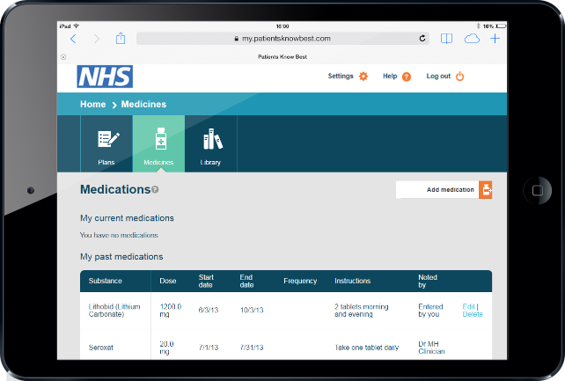
What will the Care Information Exchange do?
Support person-centred, integrated health and social care in North West London by:
giving individuals access to information about their care held by different health and social care providers
allowing individuals to share that information with health and social care professionals
providing secure messaging, shared care planning, and symptom tracking for individuals and professionals

Slide 3
What will it mean for individuals?
The ability to view, add and share information about their care.
The opportunity to take more control of their own health and care.
New ways of communicating with health and social care professionals in their network.

Slide 4
What will it mean for professionals?
The confidence of having a more complete record of care
Tools to support communication with fellow health and social care professionals and with individuals
The opportunity to change ways of working to improve delivery of care

Slide 5
What’s the current situation?
Care information about an individual is held on different systems in different parts of the NHS.
There is no secure way for professionals in all these care settings to share information.
The individual is often relied upon to relate their own care history.
GPs
Acute hospitals
Mental health hospitals
Individual
Community care
Social care

Slide 6
What will be different with CIE?
GPs
The Care Information Exchange will help to break down the barriers between the different care settings.
The individual will share their care information with professionals, if they choose to.
Secure messaging and shared care planning will support coordination and integrated care.
Community care
Individual
Acute hospitals
Social care
Mental health hospitals

Slide 7
Our supplier: Patients Know Best
At the heart of the Care Information Exchange is a system provided by Patients Know Best, which is used by around 30 hospitals in the UK.
UK Case study
Luton and Dunstable University hospital: 2,840 patients with inflammatory bowel disease. | Around 800 have a stable condition and come in for regular appointments.
The system allows those stable patients to assess their condition, get help material and communicate with the team. | Routine appointments no longer needed. More capacity for patients if condition flares up.

Slide 8
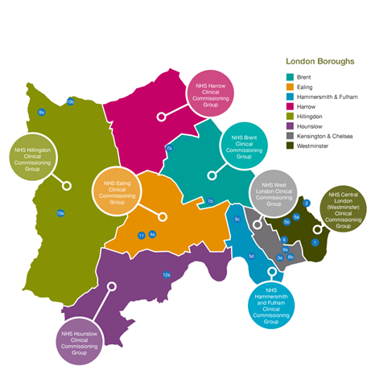
Who will be involved?
The programme has the potential to involve GPs from eight CCGs, social care organisations, and acute, mental health and community trusts across North West London.

Slide 9
Early adopter projects
Clinical health psychology | Imperial College Healthcare | <50 patients | Audio files, Messaging, Educational materials, Journal, Care plan Video conferencing
Early intervention in psychosis | West London Mental Health Central and North West London | 14 – 35-year-olds 400 patients | Patient reported outcome measures (PROMS), Education materials, Crisis plans
Diabetes primary care | 3 GP practices in Hammersmith and Fulham | 200 patients | Care plans, Educational materials, Symptom tracking for hypoglycaemia
Diabetes secondary care | Imperial College Healthcare diabetic foot clinic Central London Community Healthcare community podiatrists | <50 patients | Uploading photographs, Care plans, messaging (e.g. medication changes)
Hillingdon Integrated Care | 16 Metro Health GP practices Central and North West London Hillingdon Hospital Social Care H4All third sector organisations | Over 65s with a long-term condition 250 patients | Care plans – GP and social care and collaborative goal settings, Clinician to clinician messaging
Neuro-oncology | Imperial College Healthcare | <50 patients | Care plans Quality of life questionnaires

Slide 10
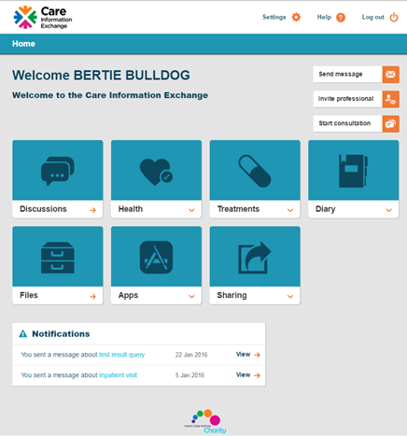
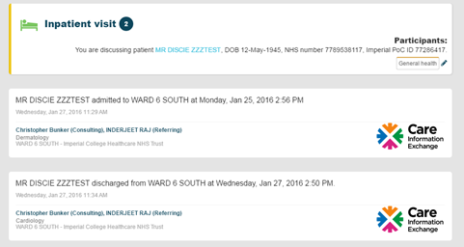
What does CIE look like?

Slide 11
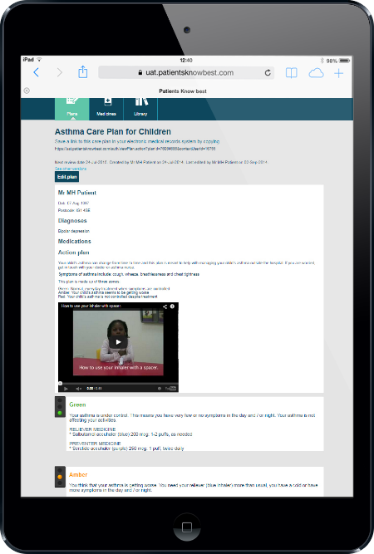
How will it work?
The Care Information Exchange will be accessed by computers, tablets and smartphones connected to the internet
Individuals and professionals who want to use the system will have accounts
Interfaces with the other information systems will make data sharing possible
Consent to see data will be controlled by the individual

Slide 12
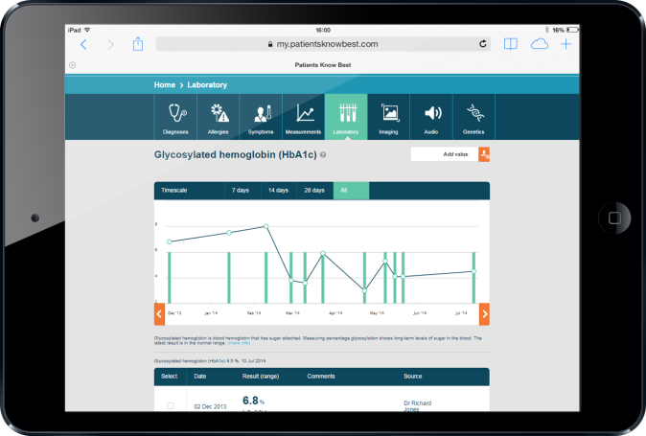
How will data be kept secure?
All participating organisations will have signed an existing Information Sharing Agreement
Information will be stored with the secure NHS network protected by the NHS firewall.
Encryption of data and control over access means that only professionals involved in an individual’s care will see that person’s information.

Slide 13
Q & A
What other Trusts in North West London are also using CIE?
Great Ormond Street, gastroenterology at St Mark’s, HIV at ChelWest.
After Imperial, which will be the next Trusts to contribute data to CIE?
Hillingdon Hospitals and London North West Healthcare.
When will GP data be available in CIE?
We are working with the GP system suppliers SystmOne and EMIS to achieve this.
How will patients access CIE?
In the pilots patients will be invited by the service team to join CIE. They will access CIE online
How will clinicians access CIE?
Initially clinicians will access CIE using a separate login. The next step will be a link direct from Cerner into CIE.
How will patient queries be handled?
Patient queries will be monitored in the pilots. We are seeking to minimise questions through system design, online help and patient communication. PALS will be the central point for questions at Imperial.

